Slide 1
More on Accessibility
March 6, 2024

Slide 2
Overview
Today
Accesibility Testing Documents
Friday
Resources for Accessibility

Slide 3
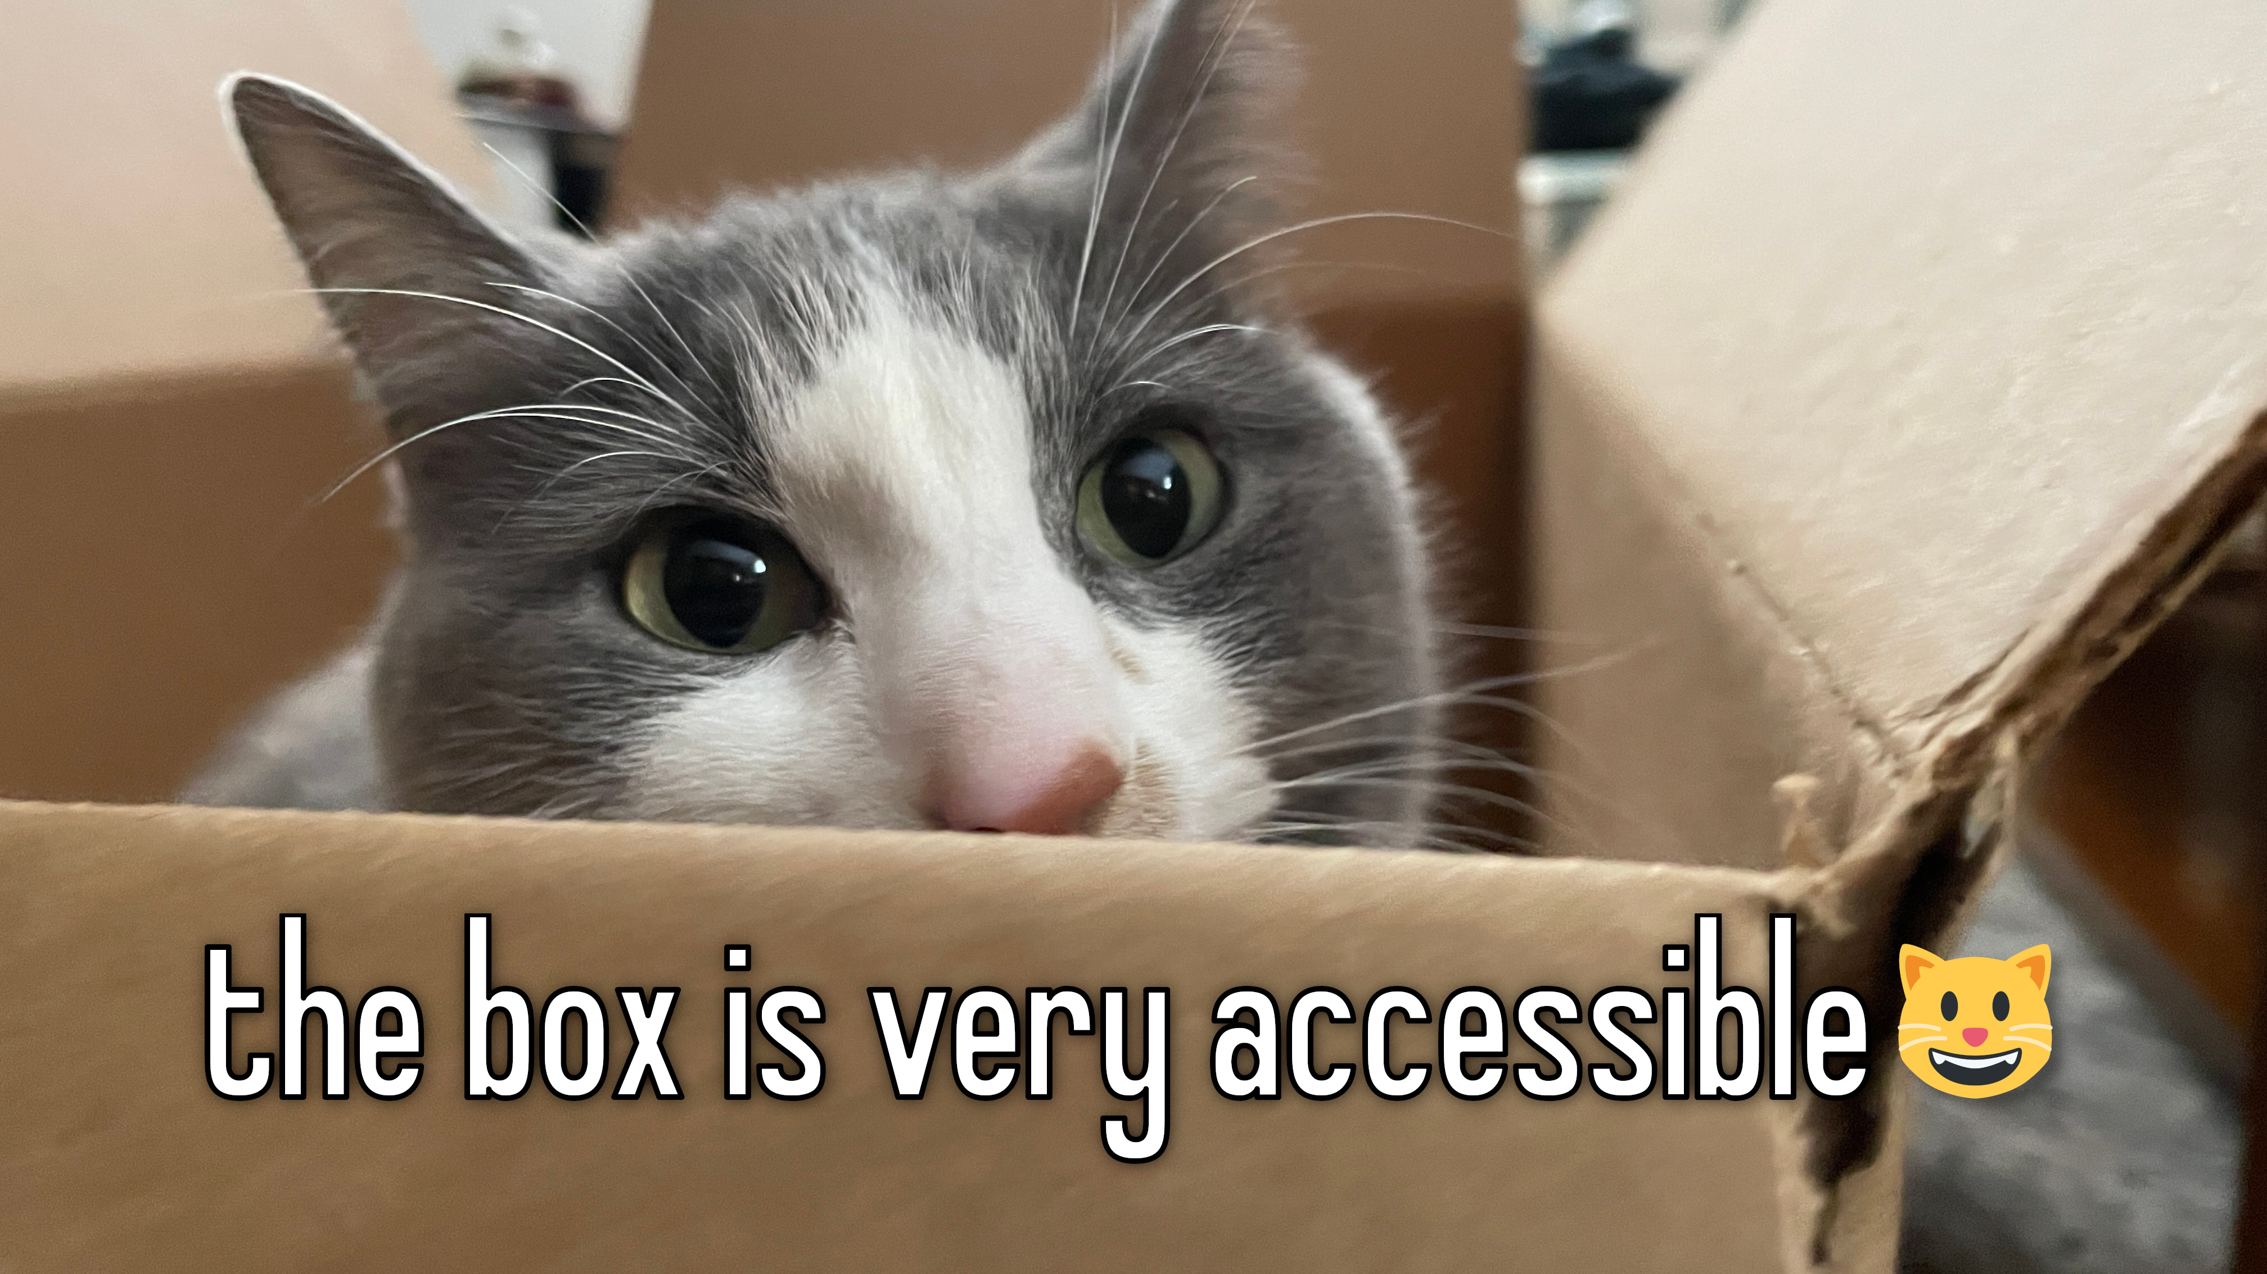
Split into groups
Perform checks of different accessibility features on a website or program that you use for school (Canvas, Joess, library website)

Slide 4
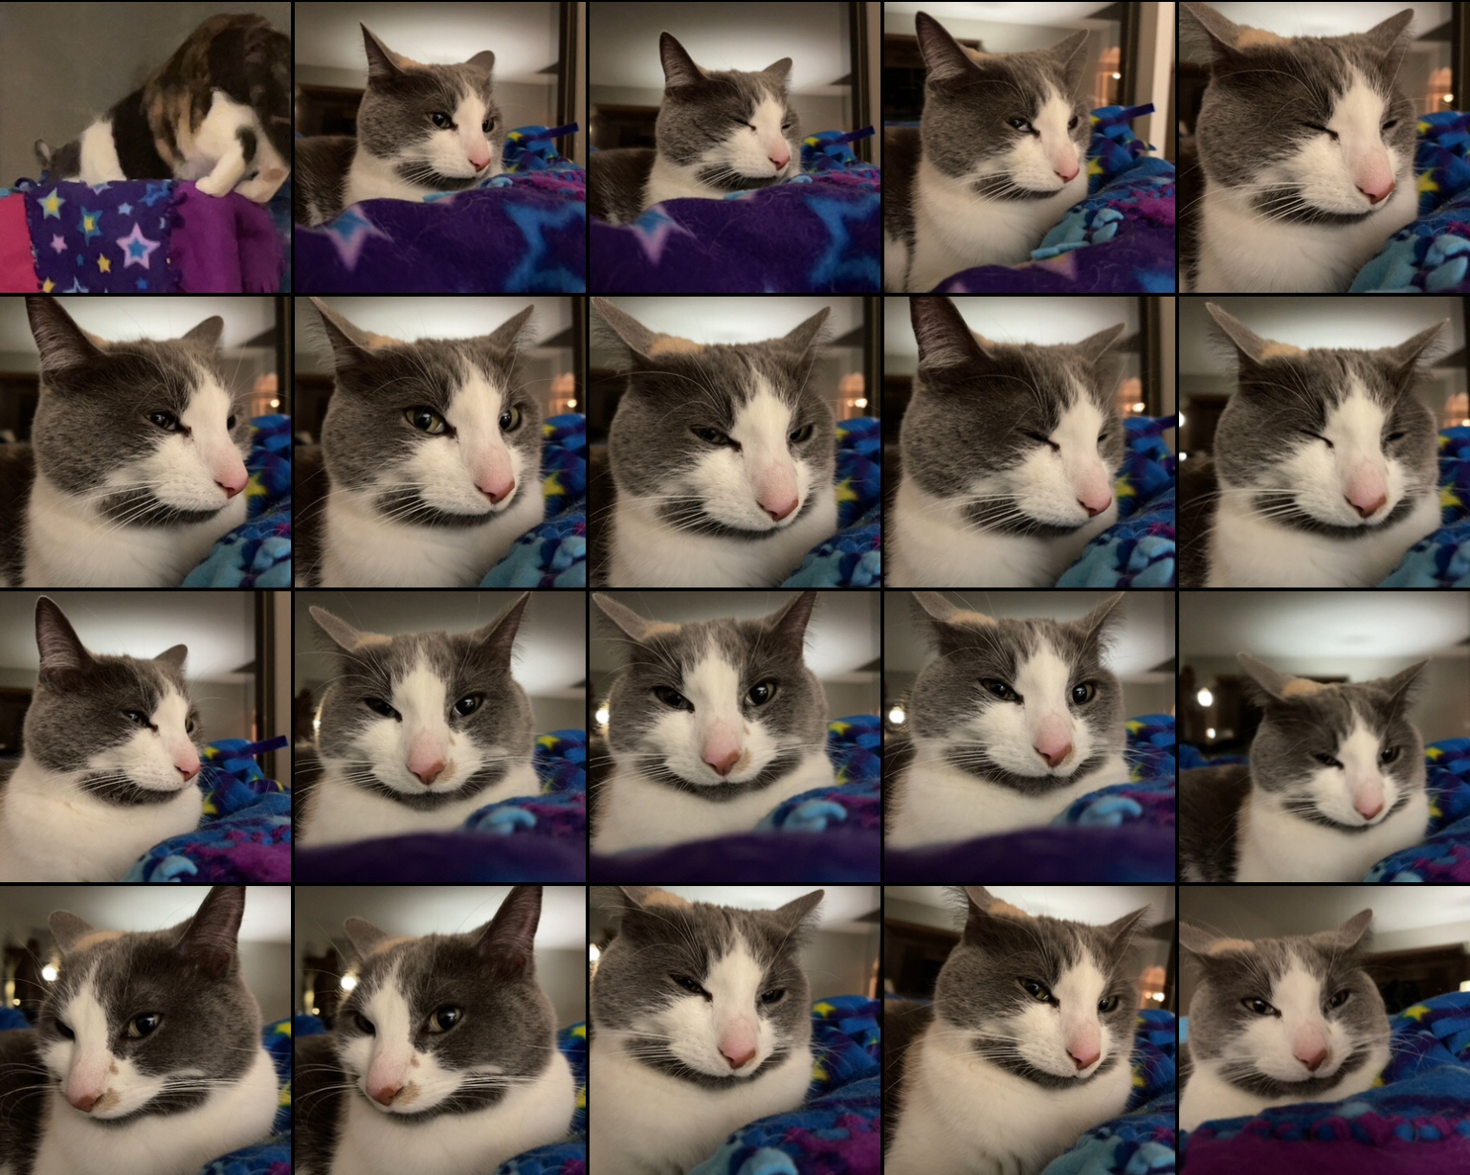
Discussion

Slide 5
Website first examinations
Go through your chosen website
Does the site mention how it makes itself or its products accessible?
In your view, what would make the site better from an accessibility standpoint?
Write a few sentences about this and submit to Canvas

Slide 6
Wrapping up
Accessibility Testing Documents due today
Resources for Accessibility due Friday

